Slide 1
Project Presentation of CO-OP Project at Industry (Module-2) (22CS421)
On
Comparison between Deep Learning Models for Early Detection of Alzheimer’s Disease Aastha
2210991129
Supervised By
Lalit Sharma
Department of Computer Science and Engineering,
Chitkara University, Punjab

Slide 2
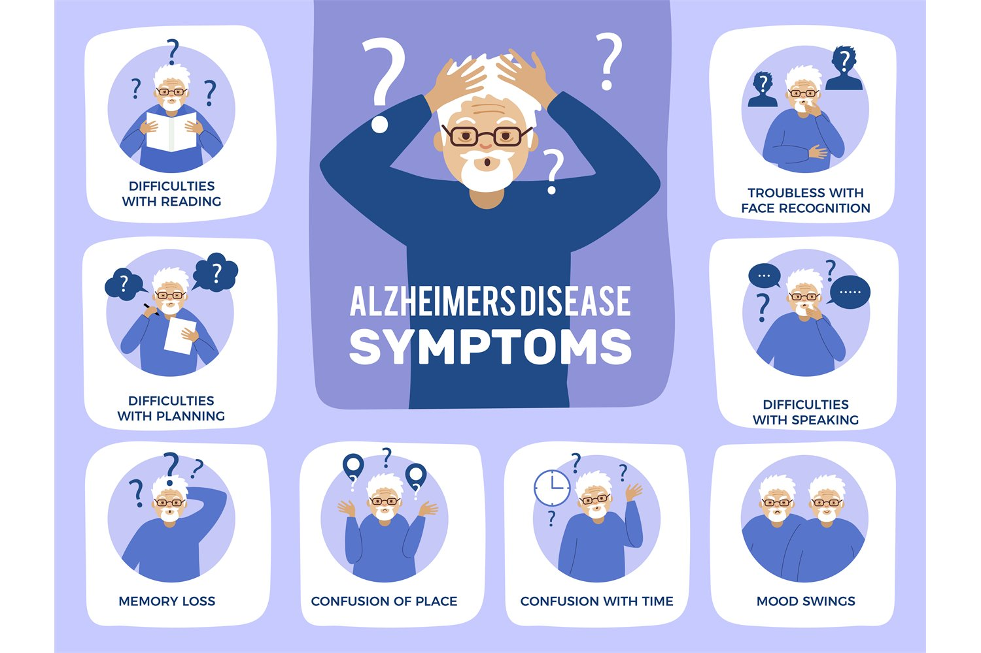
Introduction
Disease is a progressive neurodegenerative disorder affecting memory and cognition
Early detection is critical for slowing disease progression
MRI brain scans provide structural information for diagnosis
Deep Learning, especially CNNs, can automatically extract features and improve detection accuracy
2

Slide 3

Problem Statement
Manual diagnosis is:
Time-consuming
Prone to human error
Class imbalance in medical datasets reduces model performance
Need for an automated, accurate, and robust classification system

Slide 4
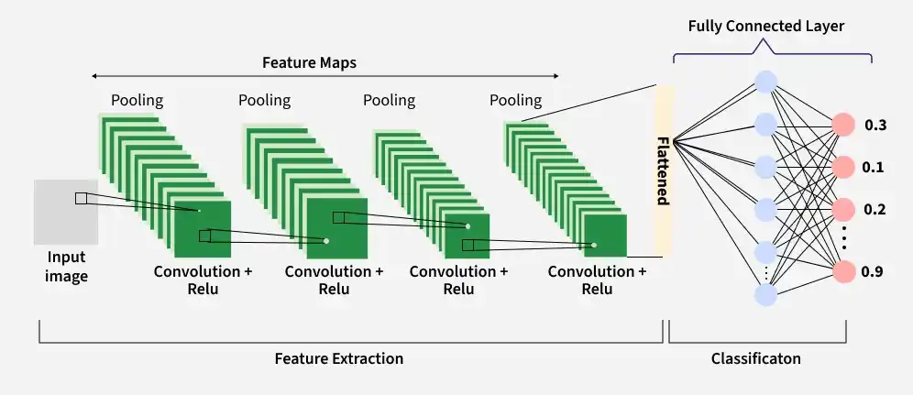
Objectives
Develop CNN-based models for Alzheimer’s classification
Compare performance of multiple architectures
Improve detection using advanced techniques
Achieve high balanced accuracy across all classes

Slide 5

Dataset
Source: Kaggle OASIS Alzheimer’s MRI Dataset
Classes:
Non-Demented
Very Mild Demented
Mild Demented
Moderate Demented
Data preprocessing:
Resizing images
Normalization
Data augmentation

Slide 6
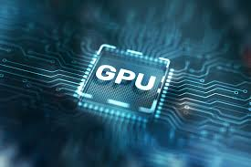
Tools & Environment
Platform: Google Colab (T4 GPU)
Libraries:
TensorFlow / Keras
NumPy, Pandas
Matplotlib / Seaborn
Hardware acceleration improved training speed

Slide 7
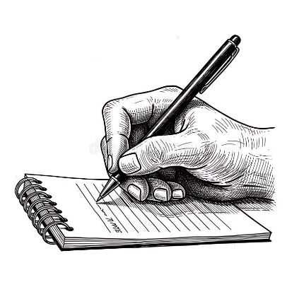
Literature Review
Reviewed 36 Research Papers
Key Insights
CNN widely used for MRI-based Alzheimer’s detection
DenseNet most frequently best-performing model
Transfer Learning improves performance
Class imbalance is a major challenge
Research Gap
Most works use:
Basic augmentation / class weighting
Limited use of:
Advanced loss functions
Robust inference techniques
My Approach
Built on DenseNet
Applied:
- Focal Loss (better imbalance handling)
-TTA (more robust predictions)
- Grad-CAM (model interpretability)
Outcome
94% Balanced Accuracy
Improved minority class detection

Slide 8
Models Used
Baseline CNN
Simple convolutional architecture
Layers:
Conv → ReLU → Pooling
Fully Connected Layers
Used as a reference model
EfficientNetB0
Pretrained model with compound scaling
Efficient in terms of parameters and performance and Fine-tuned on MRI dataset
DenseNet
Dense connections between layers
Feature reuse improves learning
Reduces vanishing gradient problem
Proposed Model (Enhanced DenseNet)
DenseNet + Advanced Techniques:
Focal Loss → handles class imbalance
TTA (Test Time Augmentation) → improves generalization
Grad-CAM → provides model interpretability
Focus on improving minority class detection

Slide 9
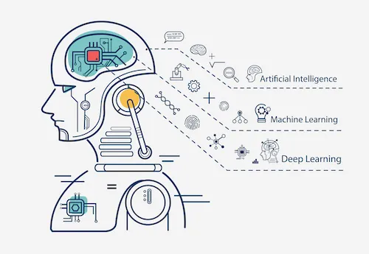
Key Techniques
Focal Loss
Reduces impact of easy samples
Focuses on hard-to-classify cases
TTA (Test Time Augmentation)
Multiple predictions per image
Improves robustness
Grad-CAM
Visual explanation technique
Highlights important brain regions

Slide 10
Results Comparison
However, the proposed DenseNet121 model achieved the highest overall performance with 85% accuracy and 0.94 balanced accuracy, outperforming the Baseline CNN and EfficientNet-B0. The macro F1-score and balanced accuracy of EfficientNet-B0 were very low, showing strong bias towards the majority class, despite having a slightly higher accuracy than the CNN model. This proves that DenseNet121 yields the best results in balancing the classification of all stages of Alzheimer’s disease, thus, is the best model.
Model | Accuracy (%) | Macro Precision | Macro Recall | Macro F1-Score | Balanced Accuracy
Baseline CNN | 77 | 0.04 | 0.25 | 0.07 | 0.25
EfficientNet-B0 | 78 | 0.19 | 0.25 | 0.22 | 0.25
DenseNet121 (Initial) | 73 | 0.68 | 0.62 | 0.55 | 0.63
DenseNet121 (Proposed) | 85 | 0.79 | 0.94 | 0.84 | 0.94

Slide 11

Limitations & Future Work
Future Work
Use larger and diverse datasets
Deploy model in real-time healthcare systems
Integrate with IoT / clinical tools
Explore hybrid deep learning models
Limitations
Dataset size limitations
Requires GPU for training
Generalization to real-world data needs validation

Slide 12
Thank You
12

